Slide 1
Agenda
What is Testing?
Different Kinds of Automated Tests
Required Tools And Setup
Writing Tests – The Three "A"s
Writing First Test
Testing User Interaction & State
Testing Connected Component
Testing Async Code
Working With Mocks
Summery & Resources

Slide 2
What is Testing?
Manual Testing
Automated Testing
Write Code <> Preview & Test in Browser
Write Code that test your code
Very Important: You see what your users will see
You test the individual building blocks of your app
Error-Prone: It's hard to test all possible combinations and scenarios.
Very technical but allows you to test ALL building blocks at once

Slide 3
Different Kinds of automated tests
Unit Test
Component Test
Snapshot Test

Slide 4
Unit Test
In this type of test, individual units or components of the software are tested.
A unit might be an individual function, method, procedure, module, or object.
A unit test isolates a section of code and verifies its correctness, in order to validate that each unit of the software’s code performs as expected.

Slide 5
Component Test
Component testing verifies the functionality of an individual part of an application.
01
Tests are performed on each component in isolation from other components.
02
Testing like this in React requires more sophisticated tools like Enzyme
03

Slide 6
Snapshot Test
A snapshot test makes sure that the user interface (UI) of a web application does not change unexpectedly.
It captures the code of a component at a moment in time, so that we can compare the component in one state with any other possible state it might take.

Slide 7
Required tools and setup
We need a tool for running our tests and asserting the results
We need a tool for "Simulating" (rendering) our React app / component
Jest
React Testing Library
Both tools are already set up for you when using create-react-app

Slide 8
Writing tests- three "a"
Arrange
Set the test data, test condition and test environment
Act
Run Logic that should be tested (eg. Execute functions)
Assert
Compare execution result with expected result

Slide 9
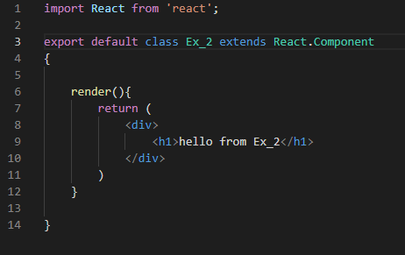
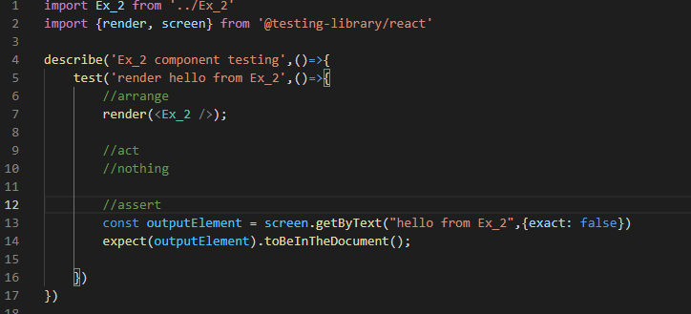
Writing first test case
Component
Test Case

Slide 10
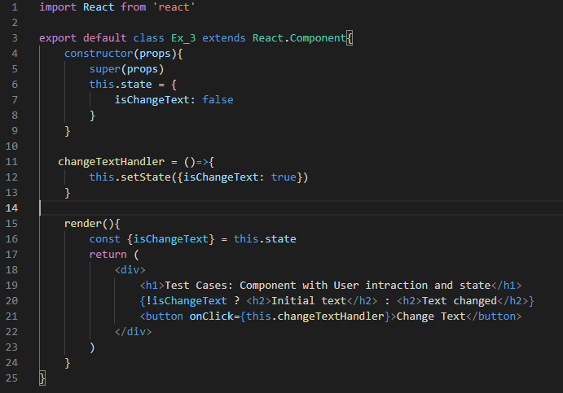
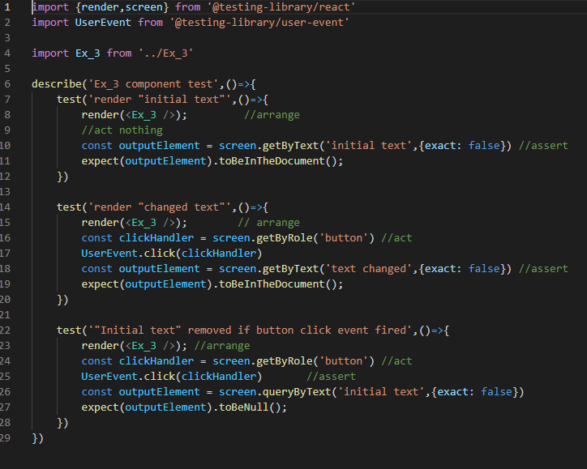
Testing user intraction & state
Component
Test Case

Slide 11
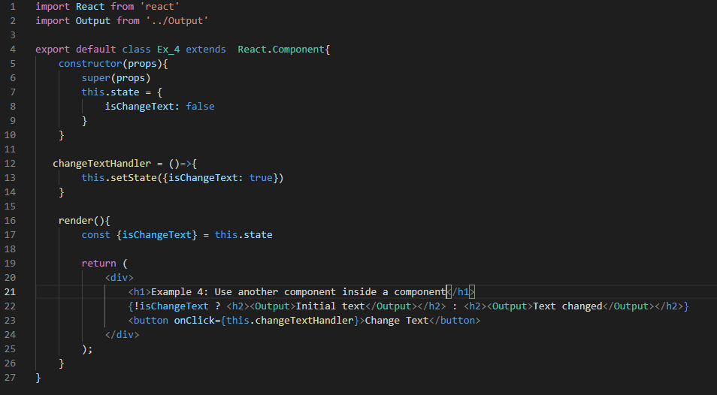
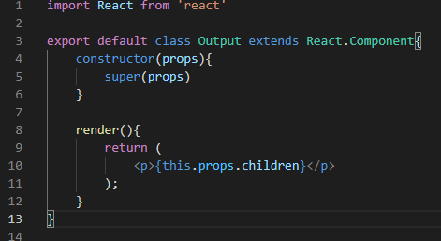
Testing Connected component
Component
Test Case

Slide 12
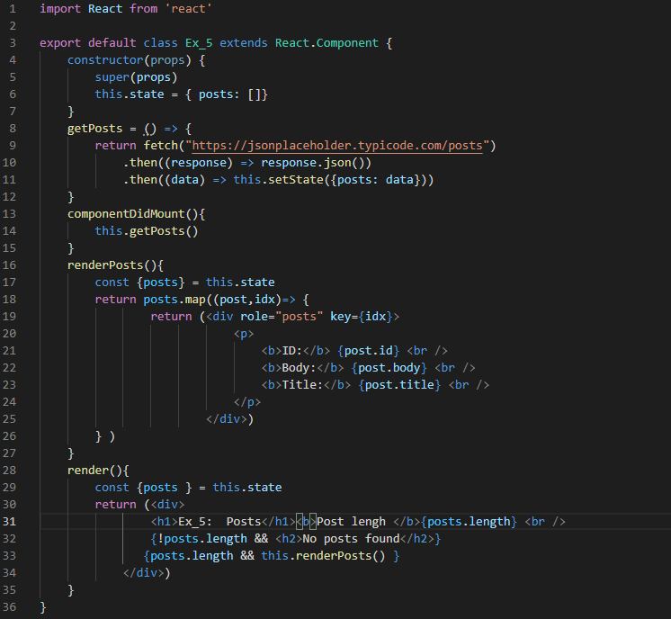
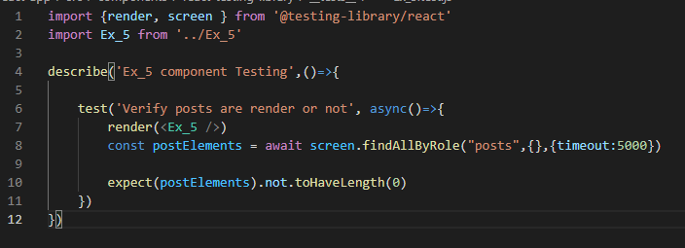
Testing async code
Component
Test Case

Slide 13
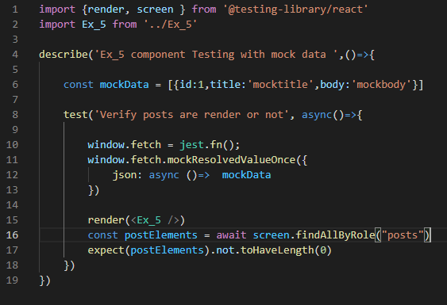
working with mocks
Component
Test Case

Slide 14
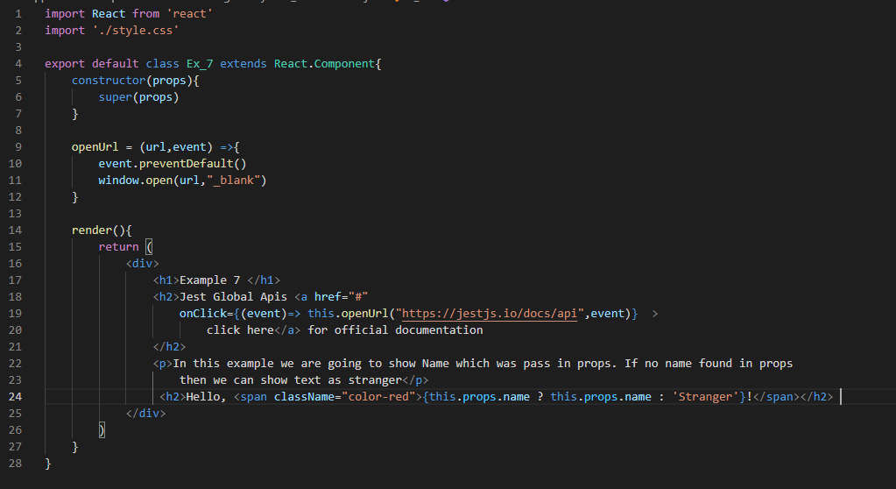
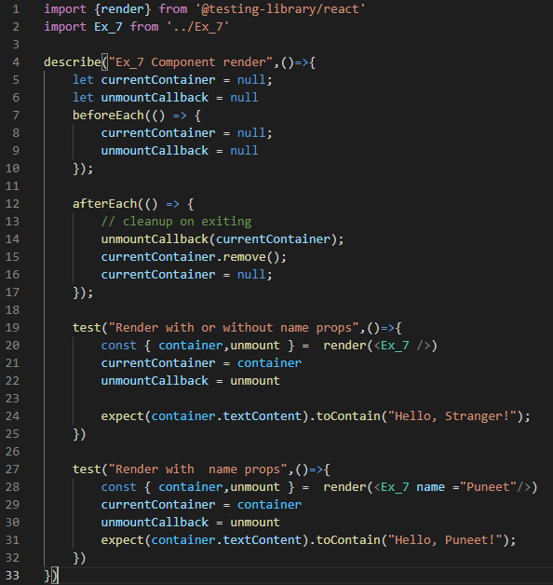
Global APIs
Component
Test case

Slide 15
Summary & Resources
Summary
Resources
Jestconfig.json file helps to provide intelligence in VS code.
Lot of global methods in jest like afterAll, beforeAll etc.
React-scripts test has a lot of options like –coverage, --watchall=false etc
For Jest official documentation https://jestjs.io/docs/api
For React Testing library official documentation https://testing-library.com/docs/react-testing-library/intro/
For Enzyme official documentation https://enzymejs.github.io/enzyme/docs/api/
To be continue.....

Slide 16
Introduction to Enzyme
Enzyme is a popular testing library from Airbnb.
It provides us with mechanism to test the implementation details of a React component. It can provide us with access to the state, props and children components of a React component while writing test.
Enzyme is a JavaScript Testing utility for React that makes it easier to test your React Components’ output.
You can also manipulate, traverse, and in some ways simulate runtime given the output.
it is focused on the implementation details of the component.

Slide 17
React testing library vs Enzyme
Differences
Conclusion
Conceptual difference
Shallow or deep rendering
Way of Operations
Setup
Sometimes, we may need to test the internals of the component when just testing the DOM from user’s perspective may not make sense. In such use cases, it is definitely wise to use Enzyme to do so.
Sometimes, it may be tempting to test each and everything when just testing the DOM is enough. In such use cases, React Testing Library is a perfect choice.
So, depending on the use cases, we can choose between these two libraries. In my view, it is totally fine to have both of them installed and use it according to their individual use cases.

Slide 18
Configure enzyme
For Reactjs 15
For Reactjs 16
npm i –D enzyme enzyme-adapter-react-15
npm i –D enzyme enzyme-adapter-react-16
For Reactjs 17
npm i –D enzyme @wojtekmaj/enzyme-adapter-react-17

